Slide 7
2010
2011
2012
2013
Notes:
GWP in g-CO2eq/kWh solar production

Slide 8
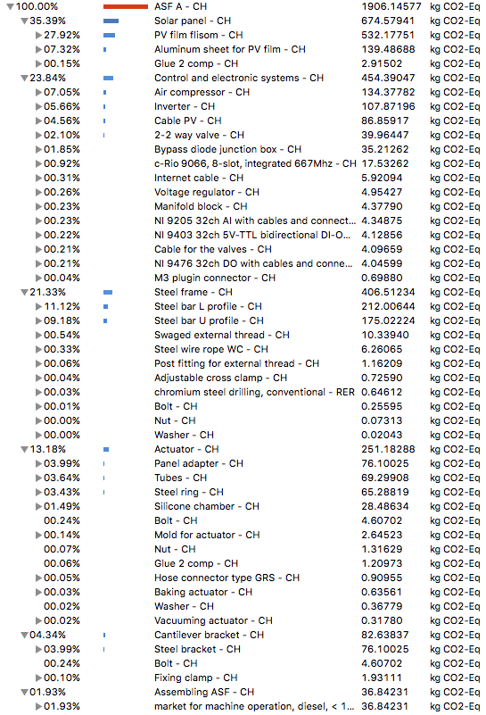
Notes:
Embodied GWP in kgCO2eq contribution tree

Slide 9
Notes:
Embodied GWP in kgCO2eq ASF pie chart

Slide 10
Notes:
Embodied GWP in kgCO2eq HONR pie chart – UPDATED for paper

Slide 11
Notes:
Embodied GWP in kgCO2eq HONR pie chart – UPDATED for paper

Slide 12
Notes:
Embodied GWP in kgCO2eq HONR pie chart – UPDATED for paper

Slide 13
Notes:
Embodied AP in kgSO2eq HONR pie chart – UPDATED for paper

Slide 14
a) Acidification Potential
b) Global Warming Potential
Total AP: 23.5kg SO_{2-eq}
Total GWP: 2676 kgCO_{2-eq}
Notes:
Embodied GWP in kgCO2eq HONR pie chart – UPDATED for paper

Slide 15
a) Global Warming
b) Terrestrial
Acidification
c) Freshwater
Eutrophication
Total GWP:
2498 kgCO₂-eq
Total TAP:
14.8kg SO₂-eq
Total FEP:
2.95kg P-eq
d) Human Toxicity
e) Metal Depletion
f) Photochemical
Oxidant Formation
Total HTP:
4530kg 1,4-DCB₂₋eq
Total MDP:
3537 kgFe-eq
Total POFP:
8.68 kg NMVOC
Notes:
Embodied GWP in kgCO2eq HONR pie chart – UPDATED for paper

Slide 16
-601.1 gCO_{2eq}/kWh
225.9
235.6
77.0
-9443.5
Heating, cooling and lighting offset
Embodied
Actuation
Maintenance
Disposal
Total
Notes:
GWP in kgCO2eq waterfall ASF in kwh at ENTSO-E mix

Slide 17
-601.1 gCO_{2eq}/kWh
225.9
235.6
77.0
-9443.5
Heating, cooling and lighting offset
Embodied
Actuation
Maintenance
Disposal
Total
Notes:
GWP in kgCO2eq waterfall ASF in kwh at ENTSO-E mix

Slide 18
-887 gCO_{2eq}/kWh
226
236
77.0
-11354
Heating, cooling and lighting offset
Embodied
Actuation
Maintenance
Disposal
Total
Notes:
GWP in kgCO2eq waterfall ASF in kwh in Frankfurt with the German Electricity Mix

Slide 19
System Expansion
2498
226
236
77.0
3037
-11354
-8318
Heating, cooling and lighting offset
Embodied
Maintenance
Actuation
Disposal
Total
Total
(with shading offset)
Notes:
GWP in kgCO2eq waterfall ASF in kwh in Frankfurt with the German Electricity Mix

Slide 20
-825 gCO_{2eq}/kWh
226
236
77.0
-14888
Heating, cooling and lighting offset
Embodied
Actuation
Maintenance
Disposal
Total
Notes:
GWP in kgCO2eq waterfall ASF in kwh in Madrid with the Spanish Electricity Mix

Slide 21
-601.1 gCO_{2eq}/kWh
225.9
235.6
77.0
-9443.5
Heating, cooling and lighting offset
Embodied
Actuation
Maintenance
Disposal
Total
Notes:
GWP in kgCO2eq waterfall ASF in kwh at ENTSO-E mix

Slide 24
Notes:
Embodied acidification potential in kgCO2eq ASF pie chart

Slide 25
Notes:
Embodied acidification potentialin kgCO2eq ASF pie chart

Slide 26
Notes:
GWP in kg-CO2eq.+incl. solar production at Swiss mix

Slide 27
ENTSO-E
ASF (CIGS) incl. shading benefits
ASF (CIGS) excl. shading benefits
Orientated solar façade (CIGS) incl. shading benefits
Orientated solar façade (CIGS) excl. shading benefits
Poly-Si
CIS
CdTe
Notes:
GWP in g-CO2eq/kWh solar production

Slide 28
ENTSO-E
CH
ASF (CIGS) ENTSO-E mix incl. shading benefits
ASF (CIGS) CH mix incl. shading benefits
ASF (CIGS) ENTSO-E mix excl. shading benefits
Orientated solar facade (CIGS) ENTSO-E mix incl. shading benefits
Flat façade mounted Poly-Si
Flat façade mounted CIS
Flat façade mounted CdTe
Notes:
GWP in g-CO2eq/kWh solar production

Slide 29
ENTSO-E
ASF (CIGS)
Orientated
static
solar facade (CIGS)
Flat facade mounted Poly-Si
Flat facade mounted
CIGS
Flat facade mounted CdTe
ASF (CIGS)
Orientated static
solar facade (CIGS)
Notes:
GWP in g-CO2eq/kWh solar production

Slide 30
ENTSO-E
ASF (CIGS)
Orientated
static
solar facade (CIGS)
Flat facade mounted Poly-Si
Flat facade mounted
CIGS
Flat facade mounted CdTe
ASF (CIGS)
Orientated static
solar facade (CIGS)
Notes:
GWP in g-CO2eq/kWh solar production

Slide 31
Germany
ASF (CIGS)
Orientated
static
solar facade (CIGS)
Flat facade mounted Poly-Si
Flat facade mounted
CIGS
Flat facade mounted CdTe
ASF (CIGS)
Orientated static
solar facade (CIGS)
Notes:
GWP in g-CO2eq/kWh solar production New Version (complete)

Slide 32
ENTSO-E
ASF (CIGS)
Orientated
static
solar facade (CIGS)
Flat facade mounted Poly-Si
Flat facade mounted
CIGS
Flat facade mounted CdTe
ASF (CIGS)
Orientated static
solar facade (CIGS)
Notes:
GWP in g-CO2eq/kWh solar production

Slide 33
Notes:
GWP in g-CO2eq/kWh solar production

Slide 34
Notes:
GWP in g-CO2eq/kWh solar production

Slide 35
Notes:
GWP in g-CO2eq/kWh solar production in Geneva

Slide 36
Notes:
GWP in g-CO2eq/kWh solar production in Frankfurt

Slide 37
CH
Servo
Individual
Soft
Actuator
Row
DE
Operation location: CH/DE
Actuator: motor/soft
Control:
Individual/row
Notes:
Sensitivity

Slide 38
CH
Servo
Individual
Soft
Actuator
Row
DE
Operation location: CH/DE
Actuator: motor/soft
Control:
Individual/row
Notes:
Sensitivity

Slide 39
Static
CH
Servo
Individual
Adaptive
Soft
Actuator
Row
DE
Operation location: CH/DE
Actuator: with/without
Actuator: motor/soft
Control:
Individual/row
Notes:
Sensitivity

Slide 40
CH
Static
Servo
ES
Individual
DE
Adaptive
Soft Actuator
Row
Operation location: CH,ES,DE
Actuator: with/without
Actuator: motor/soft
Control:
Individual/row
Notes:
Sensitivity

Slide 41
CH
Static
ES
Servo
Individual
DE
DE
Adaptive
Soft Actuator
Row
Operation Location
Kinetics
Actuator
Type
Control
Type
Notes:
Sensitivity

Slide 42
Static
CH
Servo
Individual
Adaptive
Soft
Actuator
Row
DE
Operation location: CH/DE
Actuator: with/without
Actuator: motor/soft
Control:
Individual/row
Notes:
Sensitivity

Slide 43
Static
CH
Servo
Individual
Adaptive
Soft
Actuator
Row
DE
Operation location: CH/DE
Actuator: with/without
Actuator: motor/soft
Control:
Individual/row
Notes:
Sensitivity

Slide 44
INPUT GRAPH

